Slide 1

EXPLODE
EXPLODE (OSDI 06’)
A Lightweight, General System for Finding Serious Storage System Errors

Slide 2
Current State of Data
Has turned into a vital part of everyday computing
Most tech companies have turned into or established a department in data collection.
Most notably; Google, Amazon, Uber, etc.
EXPLODE(OSDI 06’)

Slide 3
Current State of Data
Machine Learning
  Old concept, coined in 1959 by Arthur Samuel at IBM.
  Popular now due to vast amounts of data being accessible.
  Data is taken on a daily basis, most of the time without the user knowing.

Slide 4

What would happen if..
Say Elon Musk decided to tell his engineers at SpaceX to store data all in a RAID 1 configuration on a Falcon Heavy heading to Mars. An error with their storage system would likely cause an incident as seen in the movie “The Martian”.
Sure, this is an unlikely scenario, but it does drive home the importance of secure storage

Slide 5
Question Time!
Has there been a time where you personally had issues present due to data loss?

Slide 6
Introduction
Current Implementations
  Manual Inspection
  Random
  Relies on (very mad) end users
  This is probably not ideal. Especially the third point.

Slide 7
Introduction
EXPLODE
  Can check live systems
  Fast and easy: ~200 lines of C++ code
  Effective: Can be implemented across a multitude of different storage system types.

Slide 8
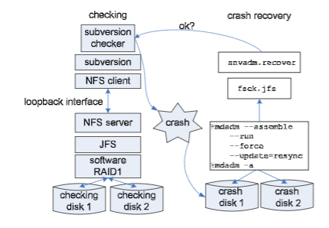
Introduction
<< Version Control on top of NFS <<on top of JFS on top of RAID 1 <<Config
EXPLODE provides interfaces allowing users to write small checker components for a modular build

Slide 9
Introduction
EXPLODE builds off from previous paper, FiSC, presented at OSDI 04’.
FiSC was very invasive due to the need of heavily modifying the Kernel to expose faults in the filesystem
EXPLODE can be run on a live system. Most of the current implementations are run on an emulation.

Slide 10
Introduction
Why is this helpful?
  Most, if not all, current storage systems already have management and configuration utilities implemented. Checkers can just be mounted and used.

Slide 11
Principles of EXPLODE
EXPLODE runs on four principles

Slide 12
Principles of EXPLODE
Explore all choices
  Do all possible options given that it is legal to do so
  Paper suggests to fork N executions, N being the number of legal operations
  Builds to the next principle:

Slide 13
Principles of EXPLODE
Exhaust States
  Do every possible action within a state (Read: Forked execution) before moving on to the next state
  Finds corner cases in well tested code within the filesystem itself.

Slide 14
Principles of EXPLODE
Touch Nothing
  Does not modify or change any paths of a filesystem.
  Run the system as-is to avoid false positives due to accidentally corrupting on board checker code.

Slide 15
Principles of EXPLODE
Report only True Errors
  Reduce error reporting to only deterministic, replayable traces.
  False positives are very expensive to check. Even deterministic ones take well over a day to diagnose.

Slide 16
How to Check a Storage System: Quick and Dirty Overview

Slide 17
Choose(N)
A function, choose(n) is provided.
If a program has N possible actions, clients will call choose(n) and it will return values 0, 1 … N-1 from each child. From that, client writes code to perform a unique action based on the return values.
kmalloc is a great example of choose in action.

Slide 18

Choose(N)
In this case, choose(2) will explore the different outcomes of kmalloc. In practice, this function rarely returns null. Choose will allow the edge case testing of this function (Does not return or returns NULL).
Notes:
Rarely returns NULL because kmalloc only fails if it is called in a situation where memory is low. Due to the complexity and power of today’s computers, this state is unlikely.
Could probably fork bomb the computer if you really wanted to cause a low memory situation. But why.

Slide 19
The Checker
Client is expected to provide a checker that that is used by EXPLODE
mutate
check
get_sig (optional)
init (optional)
finish (optional)
Notes:
Mutate: Performs system specific operations
Check: called after explode simulated crash to check for errors
Get_sig: Optional method representing the current state of the checked system. By default, records all choices made
Init and finish: Set up and clear checkers initial state.

Slide 20
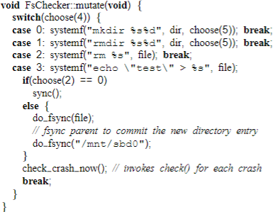
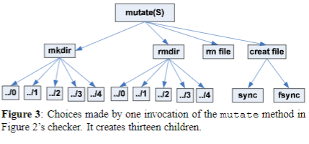
The Checker

Slide 21
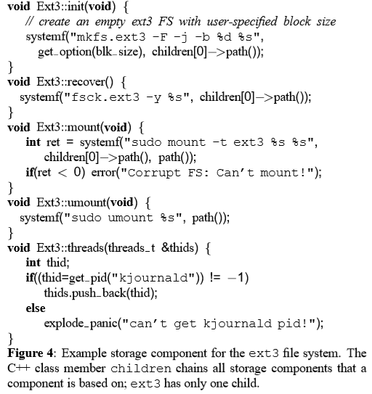
Setting Up
Client provides a storage component that implements:
Init
Mount / unmount
Recover
Threads
Notes:
Init: First time init, format partition or create fresh database
Mount / unmount: setting up / tearing down storage system so it can be used by eXplode
Recover: repair storage system after a simulated crash
Threads: returns thread IDs for kernel threads. (Reduces non determinism by only running these threads when it needs to)
Figure:

Slide 22
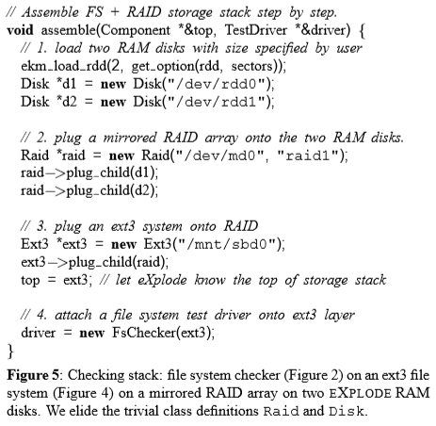
Lets Put Everything Together!
Disks are loaded
Load in RAID1 Config
Mount ext3 system on RAID
Attach Checker to ext3 layer
Notes:
Of course, this could be done with other filesystems and not just ext3. This is the great part of eXplode.

Slide 23
EXPLODE In Action

Slide 24
Implementation Overview
Very simple;
Create initial state
Choose(n); Fork n children
Create crash disks and run client provided check method
Repeat the mutate method
Notes:
Almost looks like a primitive OS,
Has a queue of saved processes, a scheduler (EKM), and does time slicing (period of time a process is allowed to run)

Slide 25
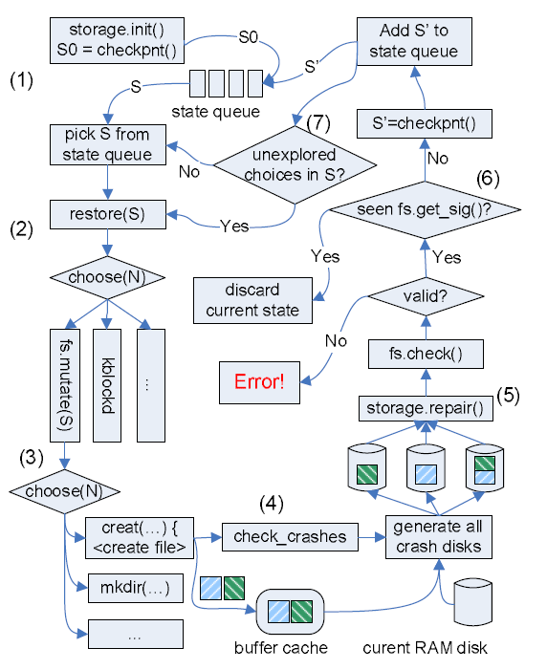
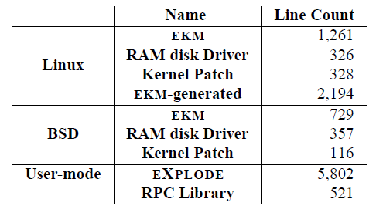
Implementation Overview
Notes:
Init: initialized the checked system, save state and put it in state queue. (Holds all the jobs to execute)
Scheduler: Selects state s, invokes choose to run either mutate or other kernel threads
mutate: basically creates and/or removes files and does its best to go through and crash the filesystem
: then it generates combination of disks that are visible after a crash
if check fails, it flags an error and records enough information to recreate the crash, if not, it just discards the state from the available choices
Only stops when state queue is empty, or the user loses patience.
Due to the amount of possible states, the idea of the state queue being empty is very slim.
After checking for crashes, fs might have a ruined internal state, hence restore() restores a clean copy of the filesystem
RAM disk driver and EKM are kernel specific, but are small by industry standards, maybe not ideal as a project for your freshman in CprE185

Slide 26
Implementation Overview
In slide 19, get_sig() is an optional method.
Based on the figure on the left, what would the implications of the client not implementing a get_sig() ?
Notes:
Ans: It would cause redundant checking, which wastes time. Remember, get_sig() discards irrelevant details to avoid redundancy.

Slide 27
Exploring Choices
Uses computation instead of copying recent states
Causes a reduction in complexity in comparison to FiSC
Saving states will exponentially costly as the choice sequence grows.
Notes:
Checkpoints set of choices that it took to get to that particular crash state instead of actually copying the whole state.
All these sets of choices are just an array of integers, since choose returns an integer.
The caveat for this however, is that the timestamps will be different. So in testing that requires the check of timing properties, this solution likely will not work.
We’ve all heard “try turning it on and off again”. Funny enough, it does work. Reboot, re-init, mount, then replay. However, by just remounting them, it clears the cache buffers due to their volatile nature.

Slide 28
Exploring Choices
Deterministic!
  Filters method calls by mostly ignoring interrupts and PIDs that are not associated with the checked system
  Threads are given the highest priority, semaphores are not included to avoid being invasive
Notes:
In addition, checked systems might have different memory allocations, data structures with different sizes, etc. However, all the systems checked, worked on use without any need to modify.
Checkers do not modify anything, therefore those issues are mostly isolated.

Slide 29
Checking Crashes

Slide 30
Crash Check Interface
check_crashes_now()
Pretty simple and straightforward
Clients can add custom logs
Log is not blocked; Client can check the logs while being able to initiate crash checking.

Slide 31
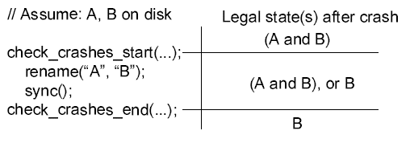
Crash Check Interface
Above example compares legal states before and after an operation that could be made in the mutate method

Slide 32
Generating Crash Disks
Linux has multiple functions that changes the eligibility of a block to be written/removed.
mark_buffer_dirty(b)
generic_make_request(req)
clear_buffer_dirty(b)
end_request(b)

Slide 33
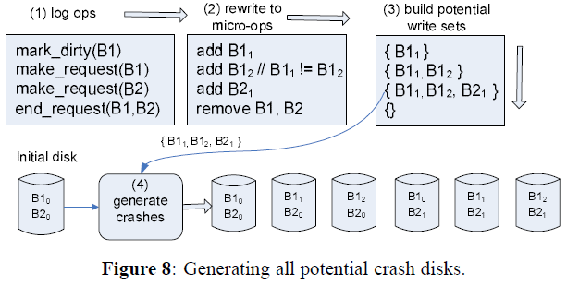
Generating Crash Disks
Write sets are built to test all potential disk crashes.
When write set shrinks, only then it will apply the write set to avoid duplicate work

Slide 34
Check Crashes During Recovery
Environmental issues correlate with each other
Power in a storm, or a bad power board causes a machine to repeatedly reboot.
EXPLODE also generates crash disks if a recover() method fails.
EXPLODE implementers seemed uninterested in this feature.
Notes:
Its possible for authors to get more indepth in this, but the attraction to this feature was not impressive.
Same goes for “soft” crashes where programs run on a filesystem crashes, and not the filesystem itself. This would be caused by either the program actually crashed on its own by encountering a terminating error, or a user does a ctrl-C, which terminates the program.

Slide 35
Results!

Slide 36
Check 1: Failed System Calls
EXPLODE found two bugs:
Unfixed VFS bug, although was documented in FiSC
ReiserFS: ftruncate() can fail with job half done if memory allocation fails
Notes:
ftruncate() = Truncates a file by precisely the size specified passed through the function

Slide 37
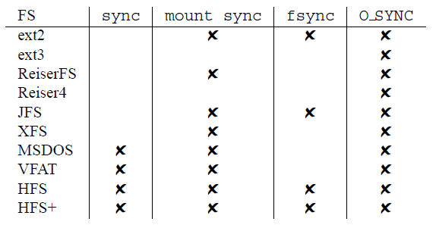
Check 2: Sync Operations
EXPLODE found 13 bugs.
Most notably:
HFS and HFS+ modified file directory and permissions, causing it to fail all tests.
Notes:
Sync: forces dirty buffers to the disk
fsync: Forces file directory dirty buffers to the disk
mount_sync: Modifications done by a system call should be on disk when the call returns
O_SYNC : The O_SYNC flag specify that write() system call will be block until all file data and metadata have been written to the disk || Fails in all FS due to a VFS limitation

Slide 38
Check 3: “Reasonable” Recovery
FS should not have any files, directories or links that were pushed to disk to be corrupted or gone, unless explicitly deleted.
A call to mkdir(/Aiman) then mkdir(/Aiman/Priester) should create that directory. No other files should be present.
Notes:
Also, if (/Aiman) was forced onto the disk before a crash, it should still be on the disk.

Slide 39
Check 3: “Reasonable” Recovery
Following was found,
ext3: No crash guarantees, files can point to uninitialized blocks
JFS: Metadata journaled can point to garbage data.
However, these were FS design choices. Not included in total bug count.

Slide 40
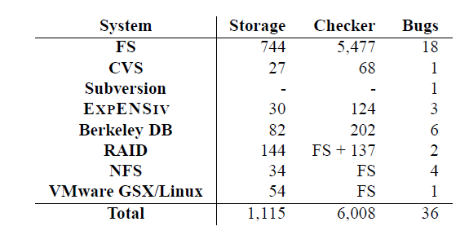
Checker Too Simple? Not Really.
Even if a client wrote a fairly simple checker, EXPLODE’s interface should still pick up errors.

Slide 41
Lets Prosecute: Berkeley DB
Checker: Mutate has a simple loop that starts a connection, adds files/records to it, then commits said file.
Calls check_crashes_start() before a commit and check_crashes_end() after to verify presence of the committed files.

Slide 42
Lets Prosecute: Berkeley DB
On ext2
  Creating a DB inside a transaction can cause a corrupted DB if FS crashes before DB is closed.
On ext3
  A crash while adding a record to an existing DB will cause it to be unrecoverable.
Notes:
Errors did differ depending on the filesystem tested, however errors occured due to the same underlying problem.

Slide 43
Lets Prosecute: NFS
Checker: Mere 15 lines of code + a manual edit of a directory to define its mount point.
Provides mount and unmount. However it does not provide recover since the filesystem underneath it should be sufficient.

Slide 44
Lets Prosecute: NFS
Bug was found where a client writes to a file, but also reads it through a link from another directory.
When reading the file, values from the first write will not be reflected.
Tests were done on multiple filesystems, all of which had the same error.

Slide 45
Portable? The case of FreeBSD
EXPLODE was ported to FreeBSD 6.0 to prove the claim of portability.
Most of the time was spent on writing a new RAM disk and the EKM module. On the user-level, only a few trivial modifications were made. Bugs were also found on this system.

Slide 46
Conclusion
Notes:
EXPLODE is proven to be a great interface for bug checking on a live system. It benefits clients by not being intrusive and implementors can quickly write checks that would more than likely find bugs.
However, it still can be improved. One of the biggest missed opportunities is to do something clever with the states. Since states are being stored and saved throughout, it only makes sense to improve on the usages of said states to make sure that EXPLODE is much more efficient in error checking.

Slide 47
Acknowledgements
Based on a paper from Junfeng Yang, Can Sar, Paul Towhey, et al.
EXPLODE (OSDI 06’)
FiSC (OSDI 04’)
Stanford University

